Slide 1


ICAEW’s BASE Competition
More than you’d imagine
icaew.com/careers

Slide 2

What is the ICAEW?
The Institute of Chartered Accountants in England and Wales (ICAEW) was founded in 1880.
ICAEW provides the ACA qualification, by completing this you become an ICAEW Chartered Accountant.
A chartered accountant is more than you can imagine. They are innovators, explorers, big thinkers and problem solvers. It’s not just about number crunching and spreadsheets.
They assess, advise, audit and analyse businesses to make them as profitable as possible.
There are currently over 181,500 ICAEW Chartered Accountants and students around the world.
Notes:
ACTIONS:
Ask students what they think an accountant does.
Use this question to dispel the myths that accountants purely deal with number crunching and spreadsheets.
Three points to dispel myths:
Accountants use their skills to help companies innovate, grow and create ambitious strategies for the future. They analyse how an organisation is performing by looking at how money flows in and out, and measuring the value of their assets.
Accountants are often involved in the biggest strategic decisions. Companies turn to them when they want to launch a new product, buy another company, or improve the way they operate.
Accountants work in every sector, from premier league football clubs to multi-national companies like ASOS.
FAQs from students
What is the ACA qualification?
The ACA (Associate Chartered Accountant) is a professional qualification from the ICAEW and is highly respected in the business world.
Those who are ACA qualified can use the letters ‘ACA’ after their name. The title reassures employers and organisations of their competence, and makes them trusted professionals.
What does ‘chartered’ mean?
Being ‘chartered’ is a badge of credibility and quality that was given to the ICAEW by The Queen.
Where can I find out more information?
ICAEW Careers video - https://www.youtube.com/watch?v=C3jAoEhTOS4
Visit https://careers.icaew.com/

Slide 3

What is BASE?
BASE is ICAEW’s national business and accounting competition for 16-17 year olds.
You don’t have to be studying a specific subject to take part - it sharpens all students employability skills.
In teams of four, you’ll take part in an online game and video presentation.
It’s an opportunity for you to compete with schools across the country to become one of the top 24 teams to make it to the National Final.
Notes:
NB: All information regarding how to take part will be given to students once they log on to the online portal after they register their team.
FAQs from students
What does BASE stand for?
Business Accounting Skills Education.
What is the online game?
This game gives students a range of scenarios a chartered accountant may experience during their career. After each section, teams choose how they would respond to situations from the options available.
How are we put into teams?
It’s up to the teacher how the teams are allocated.
What’s the presentation on?
The presentation will be linked to the situations in the online game, and will ask you to provide your recommendation to a situation.
What/where/when is the National Final?
The National Final invites the top 24 teams from the across the UK to complete in one final challenge; to create and present a business strategy to a panel of judges. This will help determine who is crowned the National Champion.
This year, the National Final takes place at The Queens Hotel in Leeds on 23-24 June 2020.

Slide 4

Why you should take part
Develop transferable employability skills such as communication, team work, decision making, presentation skills and problem solving.
You’ll also gain a greater understanding of what chartered accountants do, as well as knowing how to apply the skills learnt at school to the business world.
Strengthen your CV and stand out from other applicants for university places, apprenticeships and jobs.
The chance to network with the biggest school leaver and graduate employers and hear their advice for a successful career.
Last but not least, the opportunity to reach the National Final and win some amazing prizes!
Notes:
FAQs from students
Who are the biggest employers?
Examples of previous employers include: PwC; EY; KPMG; BDO; The National Audit Office; Smith & Williamson; Saffery Champness; RSM; Mazars.
What are the prizes?
See slide 6

Slide 5






What is the National Final?
The top 24 performing teams will be invited to The Queens Hotel in Leeds to take part in one final challenge
All finalists will receive a free overnight stay at the venue
There will be a games and network evening, and an employer exhibition
An expert in the industry will give an inspirational talk
The day will conclude with an awards ceremony and 3-course meal
A range of fantastic prizes will be awarded
Notes:
Further information:
The National Final is a fantastic two day event taking place in Leeds.
If you reach the National Final, you’ll be one of 24 teams competing in one final challenge to find out who will be crowned BASE National Champions and win some incredible prizes (see next slide).
As well as this, you’ll also receive a free overnight stay at the venue, along with some evening games and food.
You’ll be able to network with the biggest school leaver and graduate employers at the employer exhibition, to get their top tips for a successful career.
FAQs from students
When is the final?
The 2020 National Final is on 23-24 June 2020
What are the games?
These will be fairground style games that are based on the situations from the online round. Previous games have included ‘Catch the Cassava’ – much like hook a duck.
What’s the employer exhibition?
The biggest school leaver and graduate employers will have stands to allow you to network and ask questions.
It’s a chance to collect information, gain career advise and maybe even some freebies!
Who is the guest speaker?
We are currently confirming the guest speaker. Previous speakers are experts from the industry that the competition is based on such as the Head of Finance at Depop and the Director of Finance at Friends of the Earth.
What are the awards for?
We award a selection of students and teams that have performed exceptionally at the final. As well as the National Champions and Runners-up, we also have awards and prizes for categories such as top performers, communication and leadership.

Slide 6
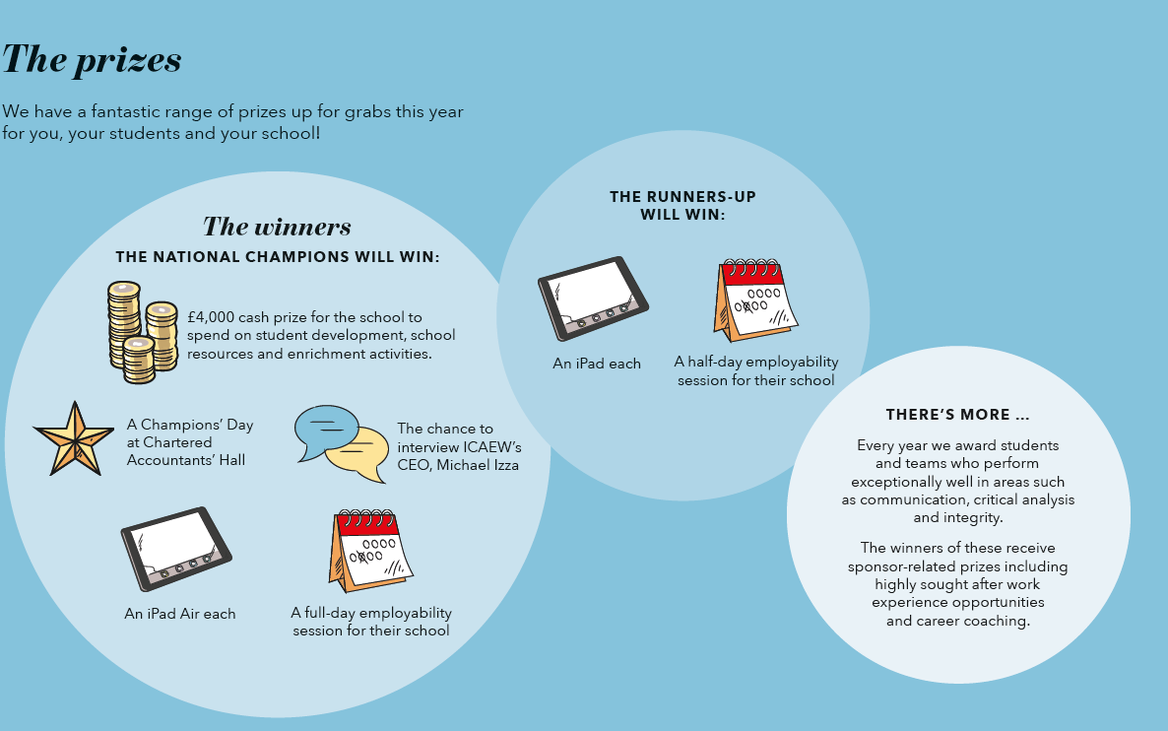
The prizes
Notes:
FAQs from students
What is the Champion’s Day?
During the day you’ll have:
a tour of Chartered Accountants’ Hall in London
the rare opportunity to interview ICAEW’s CEO, Michael Izza. You can ask him anything you like, whether that’s about the industry, or his tips for a successful career.
After the interview, we’ll also take you out for a three course lunch to celebrate.
What are employability sessions?
These are sessions hosted in school by an industry expert. The sessions will continue to enable you to make yourself as employable as possible – an invaluable prize for any future professional.

Slide 7
Notes:
Further information
ICAEW Careers video - https://www.youtube.com/watch?v=C3jAoEhTOS4
ICAEW Careers website - https://careers.icaew.com/
BASE 2019 National Final video - https://www.youtube.com/watch?v=gra9UnsgJI4&t=2s

