Slide 1
Welcome to
BASE 2020
More than you’d imagine
icaew.com/base
Notes:
Welcome to BASE!
We hope you enjoy taking part.

Slide 2
Stage 1 - Student registration
Step 1 – Go to icaew.com/base
Step 2 – Visit the Student Portal and click ‘Take Part’ to register your team
Notes:
Teacher Notes:
Student team registration opens on 13 January 2020.
Seat each team around their own computer.
The team (or teacher) needs to pick a team captain (if not already done so).
Team captain should visit the Student Portal on icaew.com/base, and click on ‘Take Part’.
Team captain enters their details and then the details of the other team members.
Teams are now ready to start the competition – Stage 2 should also be able to be completed in this class.
Use the Team Table, which can be found in your registration pack (Appendix 1) or in the BASE resources on the Teacher Portal, to record your teams. Students will remain in these teams for the rest of the competition.

Slide 3
Stage 2 - Online game
Step 1 – Make sure you’re logged into icaew.com/base
Step 2 – Click ‘Take Part’
Step 3 – Complete the online game
Notes:
Teacher Notes:
We recommend completing this stage by 28 February 2020.
The online game should take approximately 30 minutes per team.
Refer to the lesson plan in the registration pack or in the BASE resources on the Teacher Portal, for guidance for those who are struggling with the game.
If your students have time, they can start Stage 3 in this class.
TIP: We recommend setting the preparation and practise section of Stage 3 as homework, so that you have more time in the next lesson for the final practise and delivery of the presentation.

Slide 4
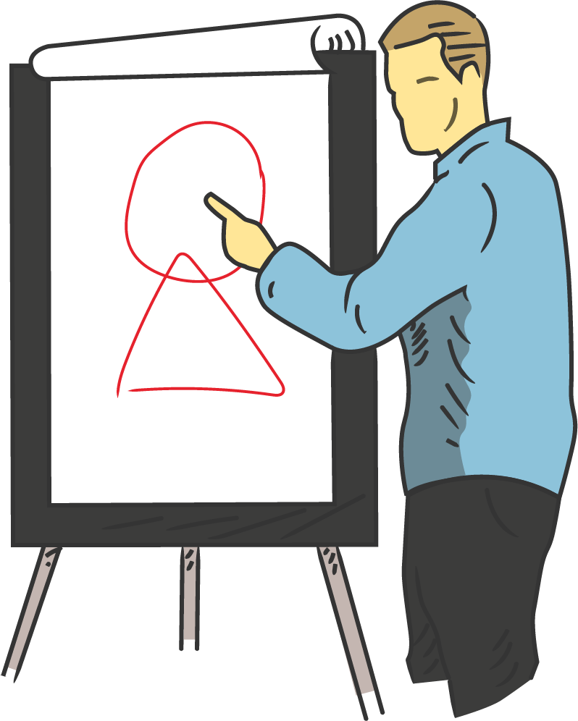
Well done!
Next, you’ll be preparing and delivering a presentation.
Notes:
Teacher Notes:
Team captains will receive feedback via email. This feedback will highlight their teams strengths and an area for improvement.
If you feel like your teams need support or advise on this feedback, you can request the Team Captain to forward this feedback on to you.
They will also receive the presentation information via email.
Decide if you would like to continue onto Stage 3 in this class, or if you would like to set another date/class to start Stage 3.

Slide 5
Stage 3 - Video presentation
Step 1 – Team captain to check emails for presentation information
Step 2 – Allocate roles within team
Step 3 – Prepare and practise presentation
Step 4 – Deliver presentation
Notes:
Teacher Notes:
This stage must be completed by 31 March 2020.
The team captains will have received the scenario, business proposals and additional supporting materials via email - you can also access these in the BASE resources section of the Teacher Portal.
The students email will also include the links required to film the presentation, but these can also be found in the Student Portal on icaew.com/base.
We recommend that it should take approximately 1 hour per team to complete steps 1-3.
Students can also prepare and practise in their own time.
Presentations cannot last longer than 5-minutes and will be cut after this time.
For assistance with this stage, please check out the lesson plan in the registration pack or in the BASE resources on the Teacher Portal.
If students encounter any tech issues contact icaew.support@capp.co

Slide 6
Your presentation should include…
Which solution would you recommend KellyMart invest in and why?
What are the key benefits, as well as any risks?
What else would you do before making the investment?
The different factors you have considered when coming up with your recommendation.
What additional research you would do before you make these investments, both desk research and on-the-ground investigation.
© ICAEW 2019
Notes:
Teacher Notes:
Please encourage students to practice their presentations as much as possible, and check they have mentioned the above points.

Slide 7
Congratulations, you’ve completed the online round!
Your responses are now being assessed.
Keep an eye out on the leaderboard at icaew.com/base to see where your team ranks alongside other schools.
We’ll be in touch at the start of the summer term to let you know if you’ve been successful in gaining a place at the National Final!
Notes:
Teacher Notes:
Both the students and teachers will be informed whether they’ve got to the National Final.

Slide 8
Further info
If you would like further information about ICAEW or accountancy careers, visit icaew.com/careers
Search our job board to find the latest vacancies at icaewtrainingvacancies.com

