Slide 2

Choosing to go to university, part 1
INTERPRETING AND REPRESENTING DATA – KEY STAGE 4

Slide 3
Mathematics content in this presentation
This slide is for information only and is hidden from the presentation. The mathematical content specifications in this presentation are those used in the Mathematics GCSE Subject content and assessment objectives and are identified in red.
S2: interpret and construct tables, charts and diagrams, including frequency tables, bar charts, pie charts and pictograms for categorical data, vertical line charts for ungrouped discrete numerical data, tables and line graphs for time series data and know their appropriate use
S4: interpret, analyse and compare the distributions of data sets from univariate empirical distributions through:
  appropriate graphical representation involving discrete, continuous and grouped data
  appropriate measures of central tendency (… mode and modal class) and spread (range, including consideration of outliers)
S6: use and interpret scatter graphs of bivariate data; recognise correlation and know that it does not indicate causation; draw estimated lines of best fit; make predictions; interpolate and extrapolate apparent trends whilst knowing the dangers of so doing
Notes:
From government specification content where:
All students will develop confidence and competence with the content identified by standard type
All students will be assessed on the content identified by the standard and the underlined type; more highly attaining students will develop confidence and competence with all of this content
Only the more highly attaining students will be assessed on the content identified by bold type. The highest attaining students will develop confidence and competence with the bold content.

Slide 4
Structure of the lesson
This slide is for information only and is hidden from the presentation.
The lesson:
introduces the application of mathematics to financial decision-making, in this case, choosing whether to go to university;
is in two one-hour parts and is flexible enough for the teacher to edit as desired; and
includes some optional homework.

Slide 5

Homework A
You were asked to do the following:
Choose a city in the UK that has a university and try to identify five key factors that influence rentals in the city.
Tip: It might be worthwhile finding out first what general factors determine rent and then see, for the city of your choice, what specific factors determine rent.
Notes:
The homework for the slide is detailed in the Lesson Plan. It is optional.
It might be worthwhile providing some guidance to pupils on key phrases to use in a search engine such as: ‘What determines rent prices in the UK?’. In Google Chrome, this phrase calls up some interesting sites including a BBC site.

Slide 6
Homework A
Let’s have a look at some of the answers:
Notes:
Ask for volunteers to present or introduce their homework results to the class. (How this is tackled by the teacher will vary depending on how willing the class is to present their ideas). It may be preferable to have group ideas presented or to choose one or two pieces of homework for the teacher to present

Slide 7
Homework A
Here are some factors specific to Leeds:
High number of visitors increasing short-term lets and reducing availability of long-term lets
Large number of jobs in sectors that recruit young people
(high tech)
Three universities creating huge student demand
Continued development of business and housing creating tenant interest
Good commuting networks that, in turn, increase business and employment within the city
Notes:
The Leeds rental market slide indicates what can be done for one city as an illustration to the class. It is indicative only as the factors are likely to vary between cities.
Other factors might include:
Good quality of life, particularly for students
Excellent external impression that Leeds is a good place to live
The standing of the University of Leeds is high as one of the leading Russell Group universities
The demographics of the area are important if there is a high proportion of young people who cannot afford mortgages but can afford rentals

Slide 8

Notes:
Meet Rohan and his family. Rohan is studying for his GCSEs at the local school. Rohan lives with his parents and his sister, Maya, and is discussing which university he should consider applying to so that he can choose his A-level subjects accordingly.
He lives in a part of the country without a university nearby and knows he will have to leave home and move if he gets a place at the list of universities he wants to apply for.

Slide 9

Task 1: why go to university
Rohan lives in a part of the country without a university nearby and knows he will have to leave home and move if he gets a place at the universities he wants to apply for.
Working in pairs, list all the reasons that you can think of that would make you choose to go to university. Think about the reasons such as making new friends. Use the sheet provided.
Notes:
The key here is to begin thinking about reasons to go to university that are not financial. Discussion of the financial factors will begin shortly. Be sure to encourage pupils to think about the non-financial factors. The aim here is simply to place financial factors relating to going to university in a broader context and not to over-emphasise the importance of any one factor.

Slide 10
Class discussion
What might be good reasons for attending university?
Which reasons might be the most important?
Notes:
Following the pupils’ work on task 1, ask the class what they thought the reasons for attending universities were. Then, ask them to prioritise (rank) which are the most important.
This will be an important task to gauge the level and quality of information pupils have about university and what their opinions are. It should naturally then lead to a focus on costs where mathematical skills can be applied.

Slide 11
Task 2: costs of university
Let’s think about the cost aspects for Rohan of attending a university in a town that is different from where he is already living.
Using the sheet provided, identify what costs Rohan is likely to face when he starts university. Be sure to think of everything that Rohan is going to pay for. Write your answer onto the worksheets provided. Identify at least three or four items under each heading.
Notes:
The link from the previous slides should show pupils that there is a natural progression to thinking about the detailed, financial factors that may be important. The key here is to begin thinking about the costs of attending university, to set the context for the subsequent mathematics work. Pupil answers should identify the ‘big ticket’ items.

Slide 12
Task 2: costs of university
Some answers
Accommodation costs | Day-to-day costs | University/studying costs
Electricity | Groceries | University fees
Gas | Eating out and socialising | Computer/laptop
Water | Hobbies, sports | Books, pens and writing pads
Council tax | Transport and travel
Home entertainment | Mobile phone
Rent and rent/security deposits | Clothes, shoes, accessories
Notes:
Emphasise that they may have different answers which are acceptable. Explore in a class discussion which are likely to be the most important items. It might be worthwhile exploring what is meant by ‘important’: it might be defined as the largest item, or an item that cannot be avoided, or an item that has to be paid first because it is due earliest. Ideally, you should get to a point where you are able to emphasise that there are quite a few factors to take into account. What is important in this session is that the pupils are able to see the range of issues and can offer perspective about which are important, helping to define priorities.
You should then focus on the ‘big ticket’ items of university fees and rent. Then turn to the rent cost and suggest that this is likely to be the biggest week-by-week cost (university fees are likely to be the largest item but these will be directly financed and don’t need budgeting for while at university because they are only repayable once students are in employment).

Slide 13
Renting a house
Rohan has read an article on a website that says that renting a room in a house is likely to be one of the biggest costs that students face when they attend university for the first time.
Rental costs vary across the country. Why?
A newspaper recently conducted an analysis of student rental costs across key university towns in England and Wales.
The report concluded that two of the key factors that influence student rental costs are:
  The mean cost to buy houses in the town being rented; and
  The number of students in the town as a proportion of the population as a whole.
Notes:
This slide should naturally follow on from the previous work so that the presenter is able to say: ‘Now that we have identified rental costs as a big item, let’s have a look at this in a bit more detail.’
Explain that most new students will probably stay in university accommodation in the first year but that subsequently they will go into the private rental sector. It is probably worth explaining that renting a private sector house involves getting together with friends who each pay a share of the rent and other costs.
The teacher will need to explain why the factors identified influence rental costs:
If the cost to buy houses is high then rentals will be high. It would be a strange situation if you were able to live in a mansion for £20 per week.
Houses available for rent are in limited supply and if rental demand is high, as it will be in towns with a high student population, then rents are likely to increase to a high level.

Slide 14
Student rental costs
University | House cost (£) | Weekly rent (£) | Student popn. (%)
University College London | 420,000 | 130.33 | 11.46
University of Bristol | 205,000 | 114.28 | 12.05
University of Cardiff | 165,250 | 81.47 | 16.84
University of Exeter | 335,000 | 117.25 | 18.63
University of Leicester | 120,500 | 90.55 | 9.00
University of Newcastle | 145,000 | 95.00 | 10.50
University of Norwich | 242,500 | 91.80 | 12.09
University of Oxford | 340,000 | 135.83 | 26.69
University of Portsmouth | 325,625 | 101.61 | 13.83
University of Reading | 440,000 | 115.79 | 14.70
Mean all data | 273,888 | 107.39 | 14.58
Notes:
Note that:
Housing costs are derived but amended from median purchase costs of terraced houses in 2015 from the Office for National Statistics Cities Data
Weekly mean rents are data derived but amended from the Royal Bank of Scotland student living index for 2016
Student population is the proportion of full-time students aged 16-74 from the 2011 census (amended).
The data has been amended in parts for presentational purposes to tell a stronger story from a correlation perspective.

Slide 15
Task 3: renting a house
is the newspaper article correct?
Split into two groups (A and B) and pair up with a friend.
Group A pairs
Produce a scatter diagram with house costs on the horizontal axis and rental costs on the vertical axis.
Draw a line of best fit to the data.
Group B pairs
Produce a scatter diagram with student population on the horizontal axis and rental costs on the vertical axis.
Draw a line of best fit to the data.
Mean data (from the previous table)
House costs: £273,888
Rental: £107.39
Student proportion of population 14.58%
Notes:
Tell the students that the line of best fit for their combination of data should pass through the coordinate for the means. So, for house costs on the horizontal axis, the line of best fit should include the coordinate specified by the mean house cost (£273,888) and the mean rental cost (£107.39). For student proportions on the horizontal axis, the line of best fit should include the coordinate specified by the mean of student proportions (14.58%) and the mean rental cost (£107.39).

Slide 16
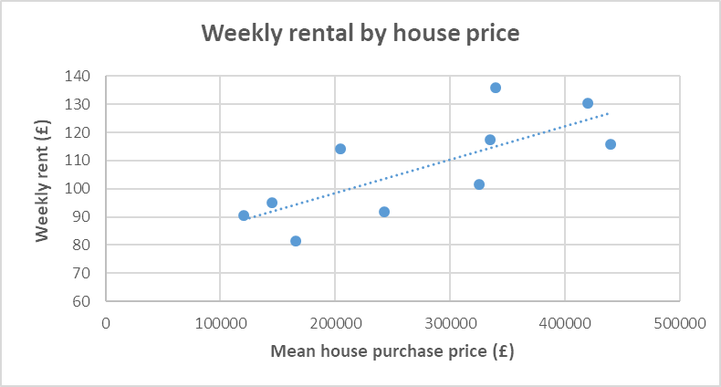
Task 3: renting a house
Weekly rental by house price
Correlation = 0.75
Notes:
The first thing to notice is that it appears that both mean house purchase costs and student populations are positively related to rental costs. This is because they have positive correlations. I didn’t ask you to calculate these but, if you’ve drawn your lines of best fit reasonably accurately, then you should be able to see that a positive correlation is reflected in the diagram. This should be apparent because the line of best fit is sloping upward.

Slide 17
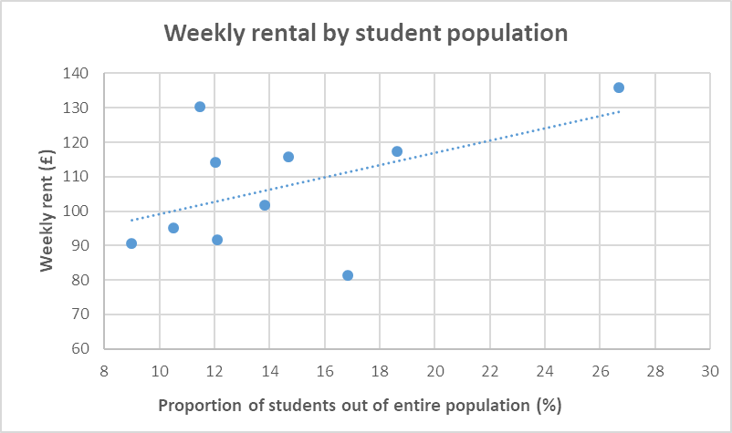
Task 3: renting a house
Weekly rental by student population
Correlation = 0.51

Slide 18
Discussion
What do you think of the following:
Do higher housing costs cause high rentals in this data?
Do higher student populations cause high rentals in this data?
Are there any outliers in the data that might distort our results?
Notes:
Note that the discussion should centre around the distinction between causation and association. Data may be associated (eg, have a positive correlation) but not have a relationship that’s causal. In this case, it looks to be a causal relationship since we might expect high housing costs and high student populations to put pressure on rental prices and because the correlations are relatively high. But generally, causation should not be confused with correlation. Causation has to be tested using hypotheses, an appropriate methodology, statistical tests and evaluation.
Oxford has concentrations of students in a relatively small town combined with very high housing costs. This may not be representative of the rest of the country and so it might be best to separate out this university and analyse it separately.
It might be right to exclude outliers because a more representative picture of the large body of data is obtained. This seems to be the case because the correlation direction changes from a positive slope to a negative slope, as can be seen from the next slide.

Slide 19
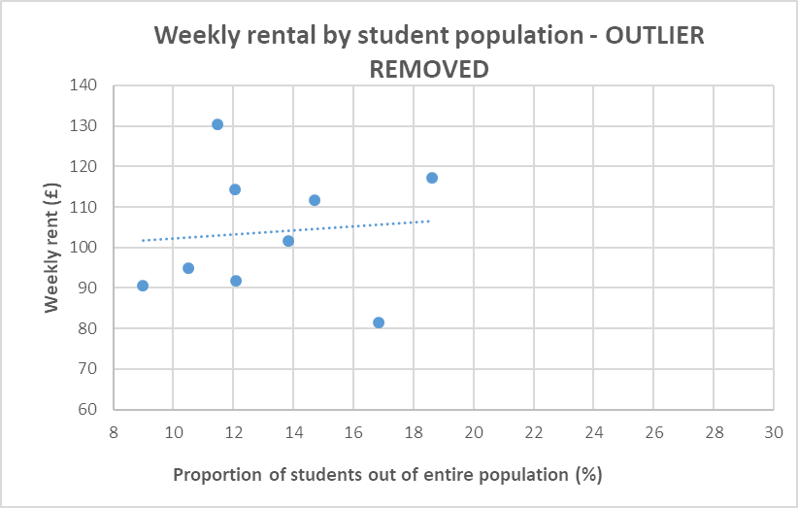
Task 3: renting a house
Weekly rental by student population
Correlation = 0.09
Notes:
Oxford may be an outlier because Oxford housing costs are very high and there is a high proportion of students in the city combined with the fact that it is a relatively small town. We might expect there to be great pressure on housing costs overall, including rentals, in such a situation. The extra factor – that Oxford is a small town with very high pressure on rental costs – means that it is probably wise to exclude it from our analysis because it introduces an additional, important factor that we have not controlled for in our data.
By excluding the data point relating to the University of Oxford we see that the correlation has changed dramatically from a positive (upward sloping) figure to one close to zero (implying – but not proving − no relationship between the data).
The outcome is that there is likely to be no relationship between student proportion and rental costs.
The conclusions for Rohan are:
He should avoid cities with high housing costs
Student proportions don’t appear to matter, except in places like Oxford.

Slide 20
Task 4: rental costs
Rohan is considering two options for university towns that his parents have mentioned:
Town X where mean house prices are £300,000. Group A: Using the line of best fit that you have drawn, find out how much rental Rohan might pay in Town X.
Town Y where student populations are very high at 28%. Group B: Using the line of best fit that you have drawn, find out how much rental Rohan might pay in Town Y.
Use the scatter diagrams you have drawn, including Oxford.
Notes:
This is an exercise in interpolation and extrapolation. Interpolation is a method of predicting data values within the range of the data provided. Extrapolation is a method of predicting data values outside the range of the data provided. Interpolation is generally more accurate than extrapolation because extrapolation is beyond our current data and hence there may be circumstances which drastically alter the relationships on which the line of best fit is drawn when extending a line beyond a data range. That is to say, extrapolation assumes that the correlation relationship continues beyond the range of the existing data so that the line of best fit can be extended in a reliable manner. This may not be so.

Slide 21
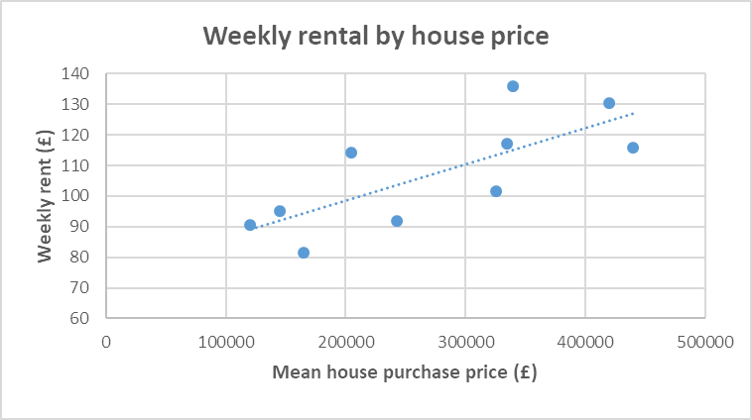
Task 4: rental costs
Weekly rental by house price − interpolation
Notes:
The interpolated rent appears to be at about £110 per week for a house purchase price of £300,000.

Slide 22
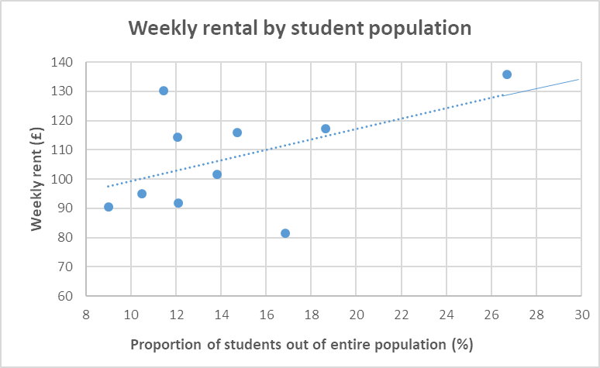
Task 4: rental costs
Weekly rental by student population − extrapolation
Notes:
Note that the line of best fit has to be extended beyond the data: this is extrapolation. Extrapolation assumes the line of best fit, as drawn for the existing data, also applies to the proportion of students beyond the existing maximum data point. The extrapolated rent appears to be at about £130 per week for a proportion of just under 28%.

Slide 23
Homework B
Borrowing to finance university education
Tuition fees to attend a university in England or Wales currently cost up to £9,250 in England and £9,000 in Wales. There are arrangements in place to pay back the loan a student takes out.
Have a look at the website below and answer the following questions.
Do I have to pay back all of the loan?
When do I have to start paying back the loan?
How much would my monthly repayments be if I earned £30,000 after graduation?
https://www.gov.uk/repaying-your-student-loan
Notes:
We’ve now got a fairly good understanding of the costs that Rohan is going to have to pay. Let’s now see how mathematics can help us understand how Rohan can make some decisions about university.

Slide 24
Choosing to go to university, part 2
INTERPRETING AND REPRESENTING DATA – KEY STAGE 4

Slide 25
Homework B
You were asked to do the following:
Tuition fees to attend a university in England or Wales currently cost up to £9,250 in England and £9,000 in Wales. There are arrangements in place to pay back the loan a student takes out.
Have a look at the website below and answer the following questions.
Do I have to pay back all of the loan?
When do I have to start paying back the loan?
How much would my monthly repayments be if I earned £30,000 after graduation?
https://www.gov.uk/repaying-your-student-loan
Notes:
We’ve now got a fairly good understanding of the costs that Rohan is going to have to pay. Let’s now see how mathematics can help us understand how Rohan can make some decisions about university.
A good alternative website is the Money Advice Service website at https://www.moneyadviceservice.org.uk/en/articles/repaying-student-loans

Slide 26
Homework B
Answers
Do I have to pay back all of the loan?
The short answer is ‘yes’ but the amount of repayment depends on what you earn after graduation. That means the actual repayment is based on the outstanding loan but will not be more than a certain percentage of your income. These are known as ‘income contingent loans’.

Slide 27
Homework B
Answers
When do I have to start paying back the loan?
All of your tuition fee loans will be under the rules for Plan 2 (for those starting university after 1 September 2012). The first repayment will either be:
April after the course finishes for full-time students; or
April four years after the course started, for part-time students.

Slide 28
Homework B
Answers
How much would my monthly repayments be if I earned £30,000 after graduation?
The website gives a specific example for Plan 2 repayments if £30,000 is earned after graduation. The rule for Plan 2 is that 9% of income over £25,000 is repaid. This would amount to, for an income of £30,000:
[ (30,000 – 25,000) x 0.09 ] /12 = £37.53 or £37 as described on the website.

Slide 29
Notes:
IF NEEDED: RECAP THIS FROM THE PREVIOUS SESSION: Meet Rohan and his family. Rohan is studying for his GCSEs at the local school. Rohan lives with his parents and his sister, Maya, and is discussing which university he should consider applying to.
He lives in a part of the country without a university nearby and knows he will have to leave home and move if he gets a place at the list of universities he wants to apply for.

Slide 30
What we’ve already done
We’ve looked at how we can help Rohan understand what costs he is likely to face when attending university. In particular, we made sure that Rohan understood how rents varied across the country at the universities he was likely to apply to.
In mathematics, we have learned:
  how to apply scatter diagrams to the rental cost data we had;
  what lines of best fit were appropriate to the data;
  to deal with outliers and what impact they had on our understanding of rent costs; and
  to interpolate and extrapolate with additional data.
Notes:
We’ve now got a fairly good understanding of the costs that Rohan is going to have to pay. Let’s now have a look to see how mathematics can help us understand how Rohan can make some decisions about university.

Slide 31
Which degree?
Rohan has heard that your choice of subject at university can affect your career earnings once you graduate.
Have a look at the data on the handout which shows starting salaries and indicative monthly loan repayments for a number of subjects once graduates start work.
Notes:
The press frequently draw attention to the importance of carefully choosing your degree subject. There are many factors that will influence subject choice and one key factor will be the career you are hoping to develop.
Students looking at jobs after university will also look at what they may be expected to earn. The following table shows some indicative salaries for various jobs and what the student loan repayment would be for the salary indicated.

Slide 32
Which degree?
Salaries and student loan repayments
 | Starting salary (£) | Monthly repayment (£)
Accountancy | 27,000 | 15.00
Actuarial work | 29,250 | 31.88
Civil engineering | 25,250 | 1.88
Management | 26,000 | 7.50
Information technology | 28,000 | 22.50
Marketing | 27,250 | 16.88
Mechanical engineering | 25,250 | 1.88
Retail management | 26,000 | 7.50
Science | 27,250 | 16.88
Veterinary science | 25,250 | 1.88
Notes:
Note: monthly repayment calculation The earnings threshold is currently (2018) £25,000 per year (or £2,083 per month) and 9% is paid on the excess over the threshold. For example, if you are paid monthly and earn £2,500 before tax per month you would repay 9% of the difference between what you earn and what the threshold is: £2,500 - £2,083 = £417, 9% of £417 = £37.53. So your student loan repayment would be £37.53 a month (in fact, the amounts are rounded down so the actual payment would be £37).

Slide 33
Task 5: which degree
Are we able to help Rohan make some sense of the data to help him decide which degree he should do?
Working in pairs, calculate the mean, median, mode and range of the data and answer the following questions that Rohan has raised:
Why are the loan repayments higher for subjects like actuarial work and information technology?
Would it be better if Rohan chose a low loan repayment course such as retail management?
Notes:
Referring to the slide:
Look at the questions and work through the tasks in the Task worksheet. What we’re trying to do is to see what mathematics can say about the data in the worksheet to help Rohan. Work in your pairs and come up with some answers. We’ll discuss what you’ve found in a minute.

Slide 34
Task 5: which degree
The mean and the median of the salaries should be close together in your calculations, but the mode is much lower. Why is the mode different?
What message is your value of the range of monthly repayments giving to Rohan?
What course would you advise Rohan to do? Why?

Slide 35
Task 5: which degree
Mean, median, mode and range
 | Starting salary (£) | Monthly repayment (£)
Mean | 26,650 | 12.38
Median | 26,500 | 11.25
Mode | 25,250 | 1.88
Range | 4,000 | 30
Notes:
First, here are the answers to the calculations. We’ll next see how to interpret them to help answer the questions.

Slide 36
Let’s look at some of the issues raised by Rohan
Why are the loan repayments higher for subjects like actuarial work and information technology?
Would it be better if Rohan chose a low loan repayment course such as retail management?
The mean and the median of the salaries should be close together in your calculations, but the mode is lower. Why is the mode different?
What message is your value of the range of monthly loan repayments giving to Rohan?
What course would you advise Rohan to do? Why?
Notes:
The loan repayments are higher in actuarial work and information technology because expected salaries are higher. It is not because these courses cost more. Remember that loan repayments are based on earnings not on the amount loaned.
Whichever subject Rohan chooses should not be based on the loan repayment level. The fact that retail management looks ‘low cost’ is because salary expectations are low.
The mode is different because it only considers the highest frequency amount appearing in the data. It does not consider what value the data is. In this instance, the mode just happens to be at a relatively low value of starting salary and loan repayments. The mean and the median take account of the value of the data (effectively, how ‘big’ or ‘small’ the number is) and hence will be calculated at approximately the ‘centre’ of the values.
The range of the monthly repayments is £30. It is large in relation to the mean and the median, and is certainly large in relation to the mode. It tells Rohan that the loan repayments vary a great deal. Since the loan repayments are based on salaries this also means that salaries vary a great deal.
Rohan should bring into consideration many other important factors when choosing a degree subject. Expected salary is one but others would be choosing a subject which interests him or for which he has the right aptitude.

Slide 37
Task 5: which degree
Answers
The loan repayments are higher in actuarial work and information technology because expected salaries are higher. It is not because these courses cost more. Remember that loan repayments are based on earnings not on the amount loaned.
Whichever subject Rohan chooses should not be based on the loan repayment level. The fact that retail management looks ‘low cost’ is because salary expectations are low.
Notes:
The loan repayments are higher in actuarial work and information technology because expected salaries are higher. It is not because these courses cost more. Remember that loan repayments are based on earnings not on the amount loaned.
Whichever subject Rohan chooses should not be based on the loan repayment level. The fact that retail management looks ‘low cost’ is because salary expectations are low.
The mode is different because it only considers the highest frequency amount appearing in the data. It does not consider what value the data is. In this instance, the mode just happens to be at a relatively low value of starting salary and loan repayments. The mean and the median take account of the value of the data (effectively, how ‘big’ or ‘small’ the number is) and hence will be calculated at approximately the ‘centre’ of the values.
The range of the monthly repayments is £31.88. It is large in relation to the mean and the median, and is certainly large in relation to the mode. It tells Rohan that the loan repayments vary a great deal. Since the loan repayments are based on salaries this also means that salaries vary a great deal.
Rohan should consider many other important factors when choosing a degree subject. Expected salary is one but other factors would be choosing a subject which interests him or for which he has the right aptitude.

Slide 38
Task 5: which degree
Answers
The mode is different because it only considers the highest frequency amount appearing in the data. It does not consider what value the data is. In this instance, the mode just happens to be at a relatively low value of starting salary and loan repayments. The mean and the median take account of the value of the data (effectively, how ‘big’ or ‘small’ the number is) and hence will be calculated at approximately the ‘centre’ of the values.
The range of the monthly repayments is £30. It is large in relation to the mean and the median, and is certainly large in relation to the mode. It tells Rohan that the loan repayments vary a great deal. Since the loan repayments are based on salaries this also means that salaries vary a great deal.
Rohan should consider many other important factors when choosing a degree subject. Expected salary is one but others would be choosing a subject which interests him or for which he has the right aptitude.

Slide 39
Task 6: presentation
Rohan has been asked by his maths teacher to present some of his work to the whole class so that his friends could also understand what it costs to go to university.
Specifically, in your pairs:
From the starting salaries data, complete the frequency table using the following class intervals (next slide)
Draw a frequency polygon of your results
What do the frequency intervals tell us about starting salaries between degree subjects?
Notes:
The task involves filling in the table in the task with the frequencies of salaries over a number of class intervals.
A frequency polygon is chosen but there are other ways of representing the data graphically.

Slide 40
Task 6: presentation
Class intervals to use
Salary range | Frequency
£25,000 ≤ x <£26,000
£26,000 ≤ x <£27,000
£27,000 ≤ x <£28,000
£28,000 ≤ x <£29,000
£29,000 ≤ x <£30,000

Slide 41
Task 6: presentation
Frequency results
Salary range | Frequency
£25,000 ≤ x <£26,000 | 3
£26,000 ≤ x <£27,000 | 2
£27,000 ≤ x <£28,000 | 3
£28,000 ≤ x <£29,000 | 1
£29,000 ≤ x <£30,000 | 1
 | 10
Notes:
The frequency table tells us that the most popular salary ranges are £25,000 to £26,000 and £27,000 to £28,000.

Slide 42
Task 6: presentation
Frequency polygon of salary intervals
Notes:
The diagram presents a visual version of the data in the previous slide and should show the same information as the data but in a manner that allows comparison between salary ranges to be made more quickly. This would depend if you prefer the information to be displayed visually!

Slide 43
There is a difference between debts that help and debts that hinder
Helpful debt
There should be a specific reason for taking out a loan.
Should make you more affluent in the long term.
You should have a sensible plan for repayment.
Example of helpful debt which shows how taking on debt could make you wealthier in the long term:
Student loans
  Graduates usually get paid more than non-graduates.
  Interest rate is relatively low.
  Pay back only when your earnings reach a certain amount.
Notes:
So, we’ve had a detailed look at the data to help Rohan. Let’s now look at some of the background factors that might add some further information for Rohan.
Explain that debt is just another term for a loan.
Position this and the subsequent slide as final considerations that might help Rohan to decide to go to university.

Slide 44
Debts that help
Mortgage
Enables you to buy a house to live in.
When the mortgage is paid off, the house will be owned by you.
Monthly mortgage payments could be cheaper than rent.
Investing in your own business
You will need to have a carefully thought through business plan.
If your business is successful it could end up being worth much more than the original loan.

Slide 45
Debts that hinder
Risky long-term outlay for short-term gain
Drain your wealth.
Offer no real prospect of the loan ‘paying for itself’ in the future.
Examples of bad debt which demonstrate risk for a quick-fix gain
A car you don’t need
If a car isn’t essential then don’t buy one.
Borrowing money to pay bills
You are likely only to increase your debt because these bills should really only be paid out of ongoing income.
A luxury holiday
Save up rather than borrow for that trip of a lifetime.

Slide 46
Final messages
Understanding finance and understanding mathematics go well together because mathematics can help with making financial decisions.
Not all financial decisions depend on understanding mathematics because, for example, your attitude towards money will play an important role.

